Slide 1
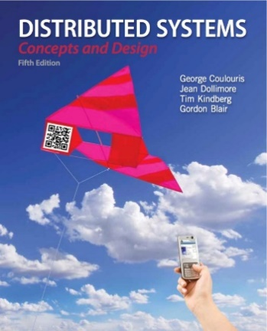
Distributed Objects Programming
- Remote Invocation
Rajkumar Buyya
Cloud Computing and Distributed Systems (CLOUDS) Laboratory
School of Computing and Information Systems
The University of Melbourne, Australia
http://www.cloudbus.org/652
Co-contributors: Xingchen Chu, Rodrigo Calheiros, Maria Sossa, Shashikant Ilager
Some concepts are
drawn from Chapter 5
Sun Java online tutorials:
http://java.sun.com/docs/books/tutorial/rmi/

Slide 2
Outline
Introduction to Distributed Objects
Remote Method Invocation (RMI) Architecture
RMI Programming and a Sample Example:
  Server-Side RMI programming
  Client-Side RMI programming
Notes:
What are the steps involved in server-side and client-side RMI?
What advanced concepts can we use to make our program production ready? Security policies to restrict access and encrypt data flow?
What exceptions will we come across? Can we dynamically deploy our service?

Slide 3
Introduction
We cover high-level programming models for distributed systems. Two widely used models are:
  Remote Procedure Call (RPC) - an extension of the conventional procedure call model
  Remote Method Invocation (RMI) - an extension of the object-oriented programming model.
Applications
Remote invocation, indirect communication
Middleware
Underlying interprocess communication primitives:
layers
Sockets, message passing, multicast support, overlay networks
TCP and UDP

Slide 4
Request-Reply Protocol
Exchange protocol for the implementation of remote invocation in a distributed system.
We discuss the protocol based on three abstract operations: doOperation, getRequest and sendReply
Client
Server
doOperation
Request
message
getRequest
select object
(wait)
execute
Reply
method
message
sendReply
(continuation)
Notes:
In the normal case, request-reply communication is synchronous because the client process blocks until the reply arrives from the server .
This request-reply protocol matches requests to replies.

Slide 5
Request-Reply Operations
public byte[] doOperation (RemoteRef s, int operationId, byte[] arguments)
  Sends a request message to the remote server and returns the reply
  The arguments specify the remote server, the operation to be invoked and the arguments of that operation
  Note: The caller of doOperation is blocked until the server performs the requested operation and transmits a reply message to the client process
Notes:
The doOperation method is used by clients to invoke remote operations. Its
arguments specify the remote server and which operation to invoke, together with
additional information (arguments) required by the operation.
The doOperation method sends a request message to the server whose Internet address and port are specified in the remote reference given as an argument.
Its result is a byte array
containing the reply.
The first argument of doOperation is an instance of the class RemoteRef,
which represents references for remote servers. This class provides methods for getting
the Internet address and port of the associated server. The doOperation method sends a
request message to the server whose Internet address and port are specified in the remote
reference given as an argument.
After sending the request message, doOperation
invokes receive to get a reply message, from which it extracts the result and returns it to
the caller. The caller of doOperation is blocked until the server performs the requested
operation and transmits a reply message to the client process.

Slide 6
Request-Reply Operations
public byte[] getRequest ()
  Acquires a client request via the server port
public void sendReply (byte[] reply, InetAddress clientHost, int clientPort)
  Sends the reply message reply to the client at its Internet address and port
Notes:
getRequest is used by a server process to acquire service requests,
When the server has invoked the specified operation, it then uses sendReply
to send the reply message to the client. When the reply message is received by the client
the original doOperation is unblocked and execution of the client program continues.

Slide 7
Failure Model of the Request/Reply Protocol
If the three primitives doOperation, getRequest and sendReply are implemented over UDP datagrams, then they suffer from:
  Omission failures
  Messages are not guaranteed to be delivered in sender order.
To allow for occasions when a server has failed or a request or reply message is dropped, doOperation uses a timeout when it is waiting to get the server’s reply message.

Slide 8
Failure Model of the Request/Reply Protocol
Timeouts
What happens if a timeout occurs?
  Return failure of doOperation to the client
  Resend the request repeatedly to the server until a reply is received

Slide 9
Failure Model of the Request/Reply Protocol
Discarding Duplicate Messages
What happens if a request is repeatedly resent?
  In cases when the request message is retransmitted, the server may receive it more than once.
  This can lead to the server executing an operation more than once for the same request
  To avoid this, the protocol is designed to recognize
  successive messages (from the same client) with the same request identifier and to filter
  out duplicates.

Slide 10
Failure Model of the Request/Reply Protocol
Lost Reply Messages
What happens if a reply is lost?
  If the server has already sent the reply when it receives a duplicate request it will need to execute the operation again to obtain the result
  Some servers may re-execute the same operation again (Idempotent operations?)
Notes:
Idempotent operations?
An idempotent operation is an operation that can be performed repeatedly with the same effect as if it
had been performed exactly once. For example, an operation to add an element to a set
is an idempotent operation because it will always have the same effect on the set each
time it is performed, whereas an operation to append an item to a sequence is not an
idempotent operation because it extends the sequence each time it is performed

Slide 11
RPC Call Semantics
As the doOperation can be implemented in different ways to provide different delivery guarantees, the main choices are:
  Retry request message
  Duplicate filtering
  Retransmission of results
Combinations of these choices lead to a variety of possible semantics for the reliability
of remote invocations as seen by the invoker.
Notes:
Retry request message: Controls whether to retransmit the request message until either a reply is received or the server is assumed to have failed.
Duplicate filtering: Controls when retransmissions are used and whether to filter out duplicate requests at the server.
Retransmission of results: Controls whether to keep a history of result messages to enable lost results to be retransmitted without re-executing the operations at the server.

Slide 12
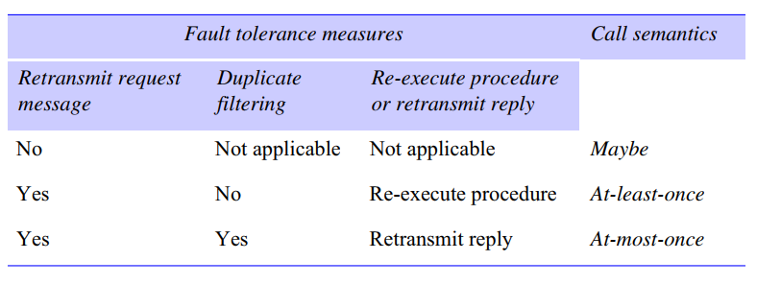

RPC Call Semantics
What about local procedure calls semantics?
Notes:
. Maybe semantics arises when no fault-tolerance measures are applied
Figure 5.9 shows the choices of interest, with corresponding names for the semantics that they produce. Note that for local
procedure calls, the semantics are exactly once, meaning that every procedure is
executed exactly once (except in the case of process failure).

Slide 13
Invocation Semantics
Middleware that implements remote invocation generally provides a certain level of semantics:
  Maybe: The remote procedure call may be executed once or not at all. Unless the caller receives a result, it is unknown as to whether the remote procedure was called.
  At-least-once: Either the remote procedure was executed at least once, and the caller received a response, or the caller received an exception to indicate the remote procedure was not executed at all.

Slide 14
Invocation Semantics
Middleware that implements remote invocation generally provides a certain level of semantics:
  At-most-once: The remote procedure call was either executed exactly once, in which case the caller received a response, or it was not executed at all and the caller receives an exception.
Java RMI (Remote Method Invocation) supports at-most-once invocation.
  It is supported in various editions including J2EE.
Sun RPC (Remote Procedure Call) supports at-least-once semantics

Slide 15
Service Interface
The term service interface is used to refer to the specification of the procedures offered by a server, defining the types of the arguments of each of the procedures.
Interface definition languages (IDLs) are designed to allow procedures implemented in different languages to invoke one another.

Slide 16
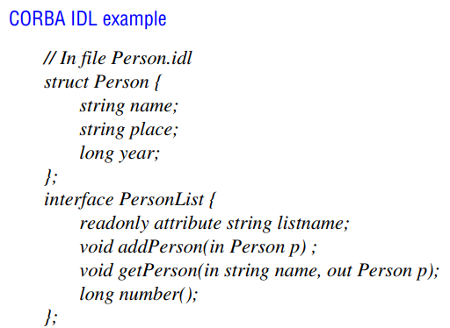
Service Interface
Notes:
Figure 5.8 shows a simple example of CORBA IDL. The Person structure is the
same as the one used to illustrate marshalling in Section 4.3.1. The interface named
PersonList specifies the methods available for RMI in a remote object that implements
that interface. For example, the method addPerson specifies its argument as in, meaning
that it is an input argument, and the method getPerson that retrieves an instance of
Person by name specifies its second argument as out, meaning that it is an output
argument

Slide 17
External Data Representation
The information stored in running programs is represented as data structures – for example, by sets of interconnected objects – whereas the information in messages consists of sequences of bytes.
The individual primitive data items transmitted in messages can be data values of many different types, and not all computers store primitive values such as integers in the same order. (Recall Big Endian!)
Another issue is the set of codes used to represent characters
Notes:
Another issue is the set of codes used to represent characters: for
example, the majority of applications on systems such as UNIX use ASCII character
coding, taking one byte per character, whereas the Unicode standard allows for the
representation of texts in many different languages and takes two bytes per character.

Slide 18
Marshalling
How can we enable any two computers to exchange binary data values then?
How about marshalling?
Notes:
One of the following methods can be used to enable any two computers to
exchange binary data values:
• The values are converted to an agreed external format before transmission and
converted to the local form on receipt; if the two computers are known to be the
same type, the conversion to external format can be omitted.
• The values are transmitted in the sender’s format, together with an indication of
the format used, and the recipient converts the values if necessary.
Marshalling is the process of taking a collection of data items and assembling
them into a form suitable for transmission in a message. Unmarshalling is the process
of disassembling them on arrival to produce an equivalent collection of data items at the
destination.

Slide 19
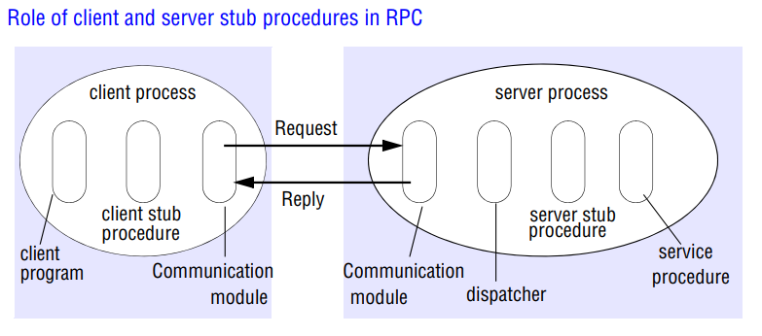
Implementation of RPC
Notes:
The client that accesses a service includes one stub procedure for each procedure in the service interface.
The stub procedure behaves like a local procedure to the client
Instead of executing the call, the stub procedure marshals the procedure identifier and the arguments into
a request message
Client Stubs perform marshalling into request messages and unmarshalling from reply messages

Slide 20
Implementation of RPC
Notes:
The client stub sends the created request message via its communication module to the server

Slide 21
Implementation of RPC
Notes:
When the reply message arrives, its client stub the results.
Client Stubs perform marshalling into request messages and unmarshalling from reply messages
Server Stubs perform unmarshalling from request messages and marshalling into reply messages

Slide 22
Implementation of RPC
Notes:
The server process contains a dispatcher together with one server stub procedure and one service procedure for each procedure in the service interface.

Slide 23
Implementation of RPC
Notes:
The server stub procedure then unmarshals the arguments in the request message, calls the corresponding service procedure and marshals the return values for the reply message.
Server Stubs perform unmarshalling from request messages and marshalling into reply messages
RPC is generally implemented over a request-reply protocol like the ones
discussed in Section 5.2.

Slide 24
Distributed Objects
A programming model based on Object-Oriented principles for distributed programming.
Enables reuse of well-known programming abstractions (Objects, Interfaces, methods…), familiar languages (Java, C++, C#...), and design principles and tools (design patterns, UML…)
Each process contains a collection of objects, some of which can receive both remote and local invocations:
  Method invocations between objects in different processes are known as remote method invocation, regardless the processes run in the same or different machines.
Distributed objects may adopt a client-server architecture, but other architectural models can be applied as well.
Notes:
Available reliably from java “2” aka Java 1.2
Has been consistently improved since then for each new Java version.
Data must be Serializable (or Remote) so that RMI can marshall (flatten) and unmarshall (reconstruct) the data
Primatives (int/float/etc) are inherently serializable, as are many Objects

Slide 25
Outline
Introduction to Distributed Objects
Remote Method Invocation (RMI) Architecture
RMI Programming and a Sample Example:
  Server-Side RMI programming
  Client-Side RMI programming
Notes:
What are the steps involved in server-side and client-side RMI?
What advanced concepts can we use to make our program production ready? Security policies to restrict access and encrypt data flow?
What exceptions will we come across? Can we dynamically deploy our service?

Slide 26
Java RMI
Java Remote Method Invocation (Java RMI) is an extension of the Java object model to support distributed objects
  methods of remote Java objects can be invoked from other Java virtual machines, possibly on different hosts
RMI uses object serialization to marshal and unmarshal
  Any serializable object can be used as parameter or method return
RMI allows the programmer to pass parameters not only by value, as input or output parameters, but also by object reference.
Releases of Java RMI
  Java RMI is available for Java Standard Edition (JSE), Java Micro Edition (JME), and Java Enterprise Edition (Java EE)
Notes:
Available reliably from java “2” aka Java 1.2
Has been consistently improved since then for each new Java version.
Data must be Serializable (or Remote) so that RMI can marshall (flatten) and unmarshall (reconstruct) the data
Primatives (int/float/etc) are inherently serializable, as are many Objects

Slide 27
RMI Architecture and Components
Remote reference module (at client & server) is responsible for providing addressing to the proxy (stub) object
Proxy is used to implement a stub and provide transparency to the client. It is invoked directly by the client (as if the proxy itself was the remote object), and then marshal the invocation into a request
Communication module is responsible for networking
Dispatcher selects the proper skeleton and forward message to it
Skeleton un-marshals the request and calls the remote object
client
server
remote
object A
proxy for B
skeleton
object B
Request
& dispatcher
for B’s class
Reply
servant
Remote
Communication
Communication
Remote reference
reference module
module
module
module
Notes:
Remote reference modules exist at client/server, and is the middleware between the stub and skeleton and the transport protocols, handling creation and management of remote references
Proxy/skel are the interfaces client/server uses to interact
Dispatcher matches the request to the appropriate skeleton (there could be many)

Slide 28
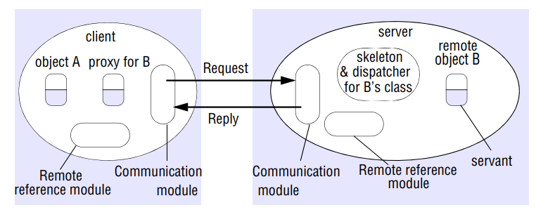
RMI Architecture and Components
Notes:
an application-level object A invokes a method in a remote application-level object B for which it holds a remote object reference.

Slide 29
RMI Architecture and Components
Notes:
The two cooperating communication modules carry out the request-reply protocol, which transmits request and reply messages between the client and server.
The communication module of the client uses only the message type, its requestId and the remote reference of the object to be invoked. The operationId and all the marshalling and unmarshalling are the concern of the RMI software

Slide 30
RMI Architecture and Components
Notes:
The communication module in the server selects the dispatcher for the class of the
object to be invoked, passing on its local reference, which it gets from the remote
reference module in return for the remote object identifier in the request message.

Slide 31
RMI Architecture and Components
Remote Object table?
Notes:
A remote reference module is responsible for translating between local and remote object references and for creating remote object references
The remote reference module in each process has a remote object table that records the correspondence between local object references in that process and remote object references (which are system-wide).
The table includes:
• An entry for all the remote objects held by the process. The remote object B will be recorded in the table at the server.
• An entry for each local proxy. The proxy for B will be recorded in the table at the client.

Slide 32
RMI Architecture and Components
Notes:
The role of a proxy is to make remote method invocation transparent to
clients by behaving like a local object to the invoker; but instead of executing an
invocation, it forwards it in a message to a remote object.
There is one proxy for each remote object for which a process holds a remote object reference.
It hides the details of the remote object reference, the marshalling of arguments, unmarshalling of results and sending and receiving of messages from the client.

Slide 33
Invocation Lifecycle
Client
Server
Client Code
RMI Object
Invoke method via stub
Returns response
Calls actual method with args
Returns response / exception
1
8
4
5
Stub
Skeleton
Serializes arguments, transmit
Receives, deserialises response
Receives, deserialises arguments
Serialises response, transmit
2
7
3
6
Network

Slide 34
Outline
Introduction to Distributed Objects
Remote Method Invocation (RMI) Architecture
RMI Programming and a Sample Example:
  Server-Side RMI programming
  Client-Side RMI programming
Notes:
What are the steps involved in server-side and client-side RMI?
What advanced concepts can we use to make our program production ready? Security policies to restrict access and encrypt data flow?
What exceptions will we come across? Can we dynamically deploy our service?

Slide 35
Steps for implementing an RMI application
Design and implement the components of your distributed application
  Remote interface
  Servant program
  Server program
  Client program
Compile source code and generate stubs
  Client proxy stub
  Server dispatcher and skeleton
Make classes network accessible
  Distribute the application on server side
Start the application
Notes:
Many steps to creating a remote service
-Inteface defines a set of methods we wish to make available (based on user requirements and agreement)
-Servant implements the methods defined in Interface
-Server program is the “driver”, usually registers with naming service
REPEAT IF NECCESSARY

Slide 36
RMI Programming and Examples
  Application Design
    Remote Interface
      Exposes the set of methods and properties available
      Defines the contract between the client and the server
      Constitutes the root for both stub and skeleton
    Servant component
      Represents the remote object (skeleton)
      Implements the remote interface
    Server component
      Main driver that makes available the servant
      It usually registers with the naming service
    Client component

Slide 37
Example application – Hello World
Server side
  Create a HelloWorld interface
  Implement HelloWorld interface with methods
  Create a main method to register the HelloWorld service in the RMI Name Registry
  Generate Stubs and Start RMI registry
  Start Server
Client side
  Write a simple Client with main to lookup HelloWorld Service and invoke the methods

Slide 38
1. Define Interface of remote method
//file: HelloWorld.java
import java.rmi.Remote;
import java.rmi.RemoteException;
public interface HelloWorld extends Remote {
public String sayHello(String who) throws RemoteException;
}

Slide 39
2. Define RMI Server Program
// file: HelloWorldServer.java
import java.rmi.Naming;
import java.rmi.Remote;
import java.rmi.RemoteException;
import java.rmi.server.UnicastRemoteObject;
public class HelloWorldServer extends UnicastRemoteObject implements HelloWorld {
public HelloWorldServer() throws RemoteException {
super();
}
public String sayHello(String who) throws RemoteException {
return "Hello "+who+" from your friend RMI 433-652 :-)";
}

Slide 40
2. Define RMI Server Program
public static void main(String[] args) {
String hostName = "localhost";
String serviceName = "HelloWorldService";
if(args.length == 2){
hostName = args[0];
serviceName = args[1];
}
try{
HelloWorld hello = new HelloWorldServer();
Naming.rebind("rmi://"+hostName+"/"+serviceName, hello);
System.out.println("HelloWorld RMI Server is running...");
}catch(Exception e){
e.printStackTrace();
}
}
}

Slide 41
3. Define Client Program
// file: RMIClient.java
import java.rmi.Naming;
public class RMIClient {
public static void main(String[] args) {
String hostName = "localhost";
String serviceName = "HelloWorldService";
String who = "Raj";
if(args.length == 3){
hostName = args[0];
serviceName = args[1];
who = args[2];
}
else if(args.length == 1){
who = args[0];
}
try{
HelloWorld hello = (HelloWorld)Naming.lookup("rmi://"+hostName+"/"+serviceName);
System.out.println(hello.sayHello(who));
}catch(Exception e){
e.printStackTrace();
}
}
}

Slide 42
Required Reading
Chapter 5 from the text book: Coulouris,
George F., Jean Dollimore, and Tim
Kindberg. Distributed systems: concepts and
design. Fifth Edition

